Slide 1
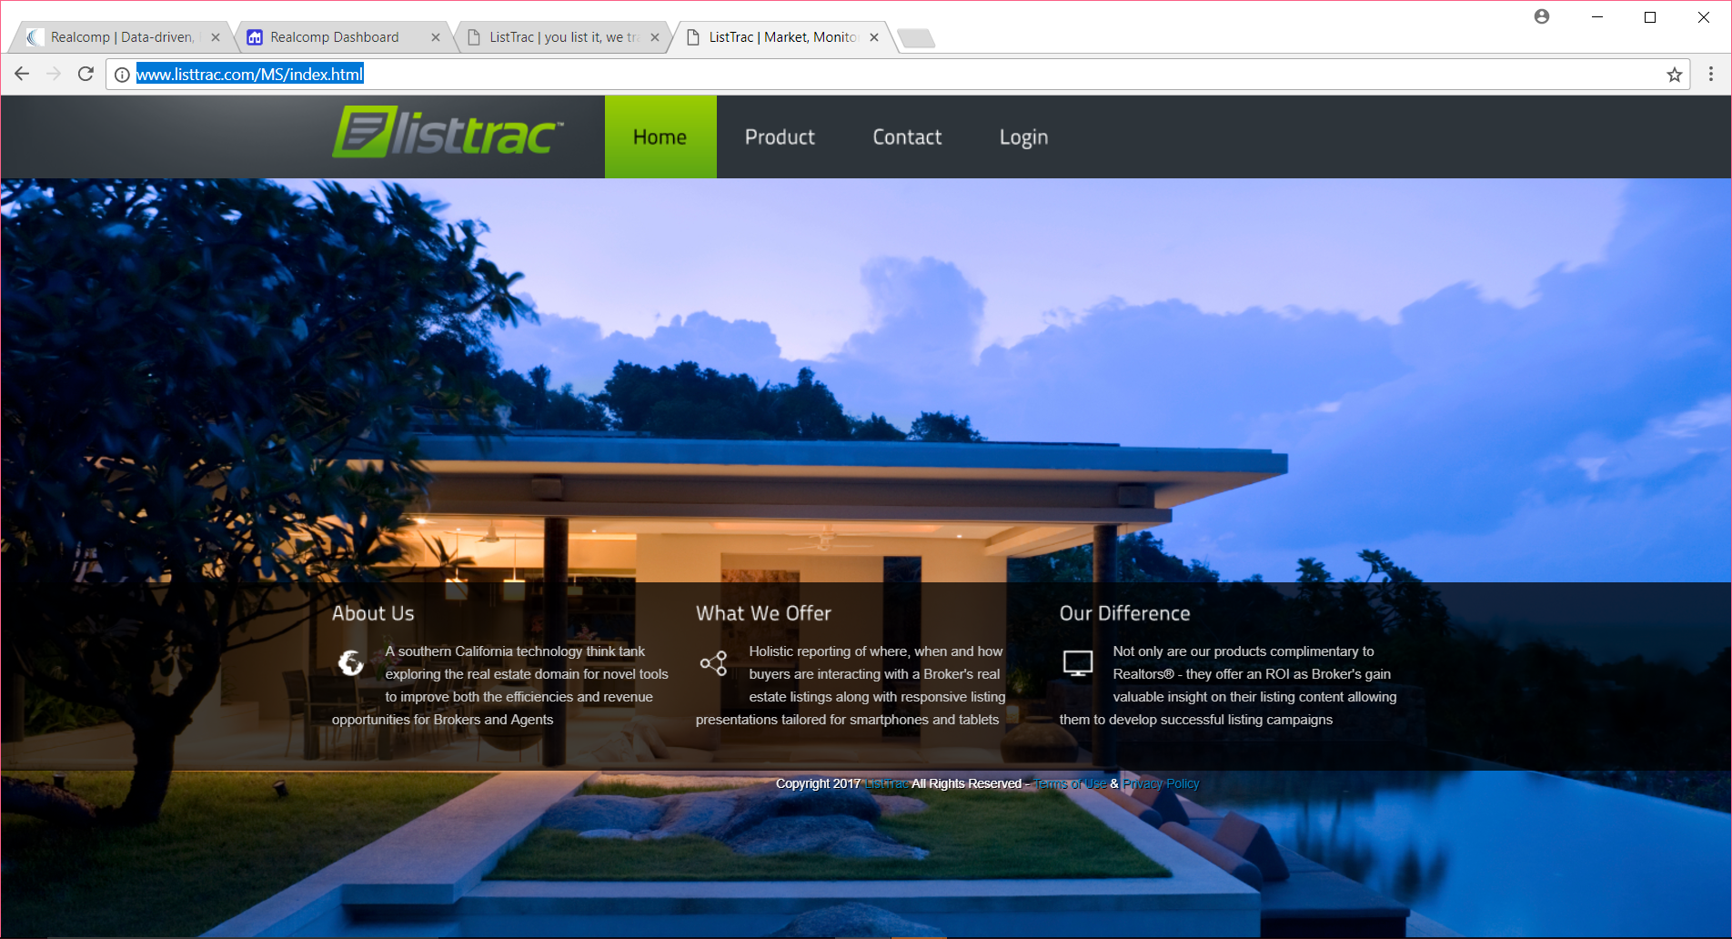
August, 2017
AS A PRIMARY SOURCE OF LEAD GENERATION FOR REALCOMP REALTORS®, Realcomp is pleased to add the ListTrac product to
our line-up of MLS integrated value-added services for
Realcomp Subscribers!
ListTrac enables Realcomp Brokers and Agents to MEASURE USER ENGAGEMENT RELATED TO YOUR LISTING CONTENT. This can help you in making more informed Internet-advertising decisions in the future.

Slide 2
August, 2017
Preview the ListTrac functions, features, and applications for your marketing efforts here…

Slide 3
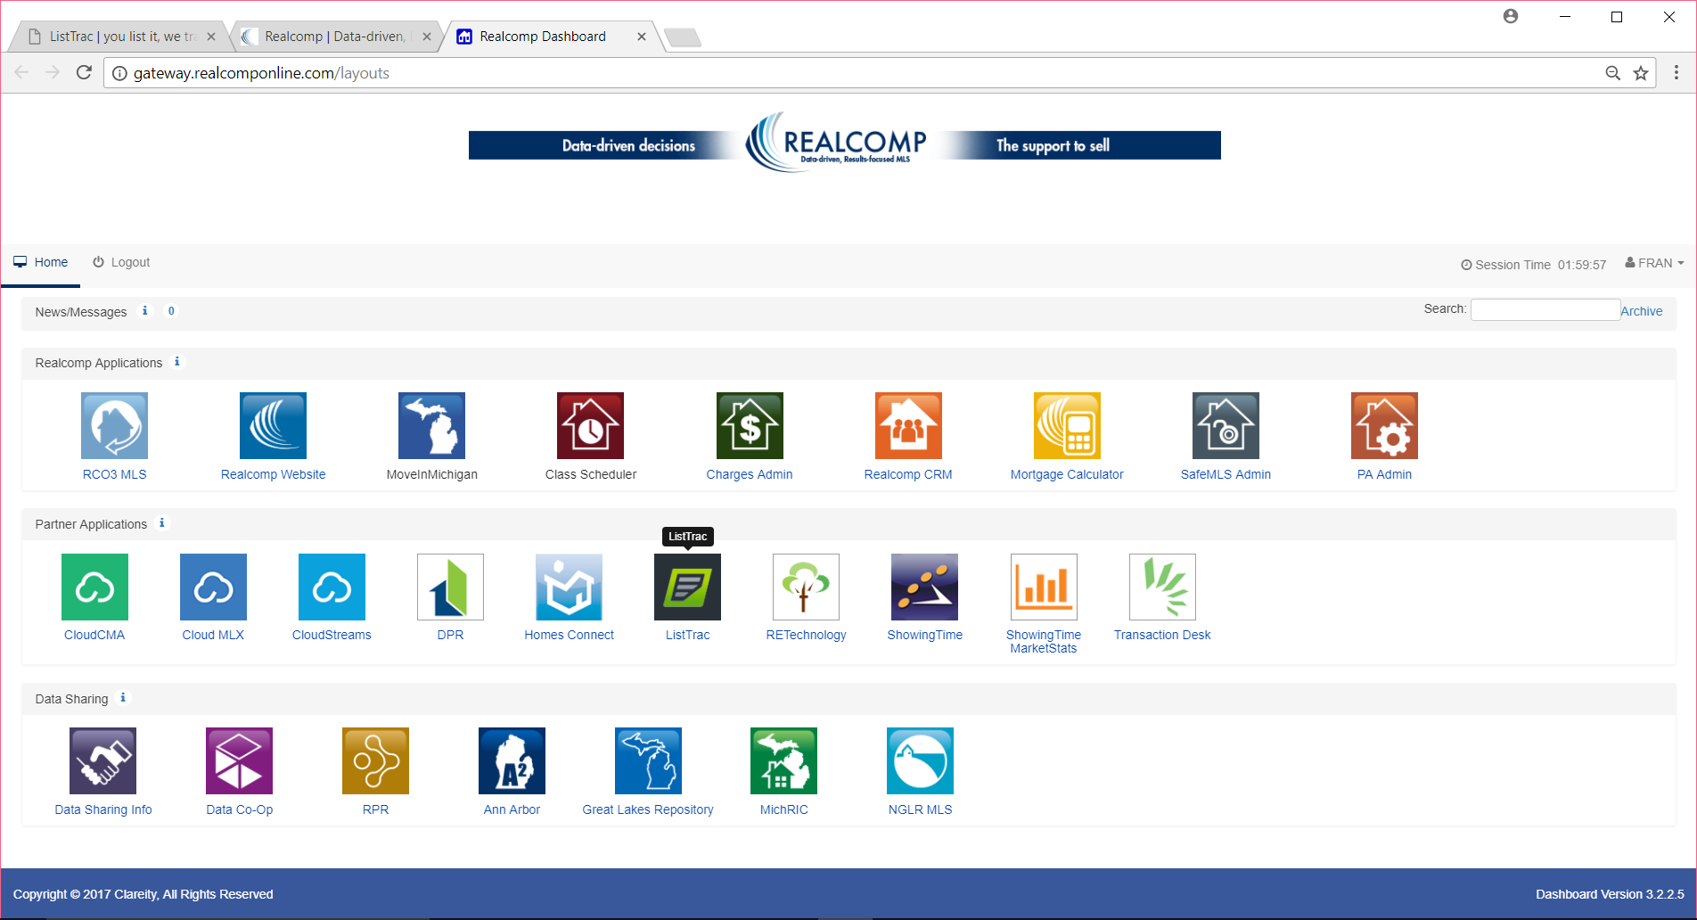
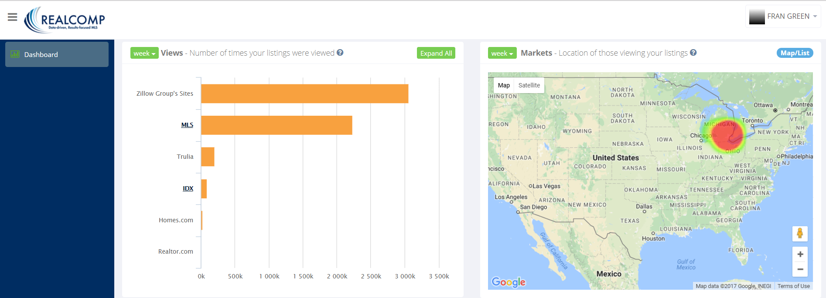
Access ListTrac from the Realcomp Login Dashboard icon (circled below).
Brokers can access ListTrac metrics for your entire brokerage (by office
and/or by agent).
Agents can access ListTrac metrics
for your personal listings.

Slide 4
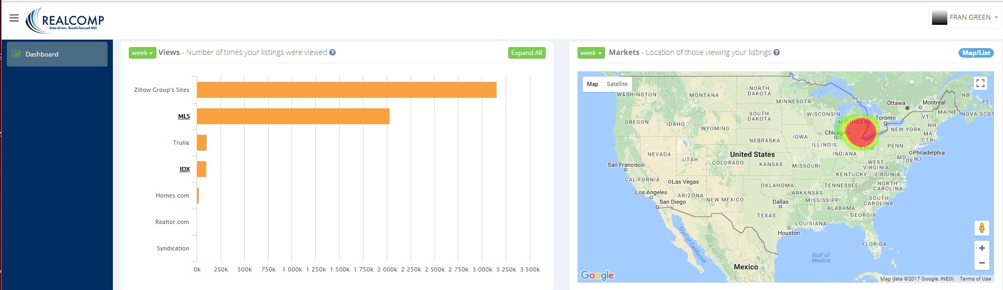
Available Metrics Under the “Dashboard” Menu Item
ListTrac provides you with listing metrics in the following categories:
Views | Markets | Inquiries | Visitors | Saved Listings | Shares | Inventory | Active Reports
Additional details follow regarding these metrics.

Slide 5
Views | Markets | Visitors | Inquiries | Saved Listings | Shares | Inventory | Active Reports
1
2
Views: Shows the number of times your listings have been viewed through various websites.
Markets: Shows the physical location of those who have viewed your listings.
Note: “Views” obtained through the MLS are usually considered to be
from serious/committed buyers.

Slide 6
Views | Markets | Visitors | Inquiries | Saved Listings | Shares | Inventory | Active Reports
“Views” encompasses metrics obtained from the Zillow Network, the Realcomp MLS, Realcomp’s IDX data (via Broker & Agent websites), and Homes.com.
Important Note: Realtor.com is only providing this data for a limited number of brokerages currently. If you would like to see your Realtor.com listing traffic, please contact
your Realtor.com representative and let them know that having this
capability through ListTrac is important to you!

Slide 7
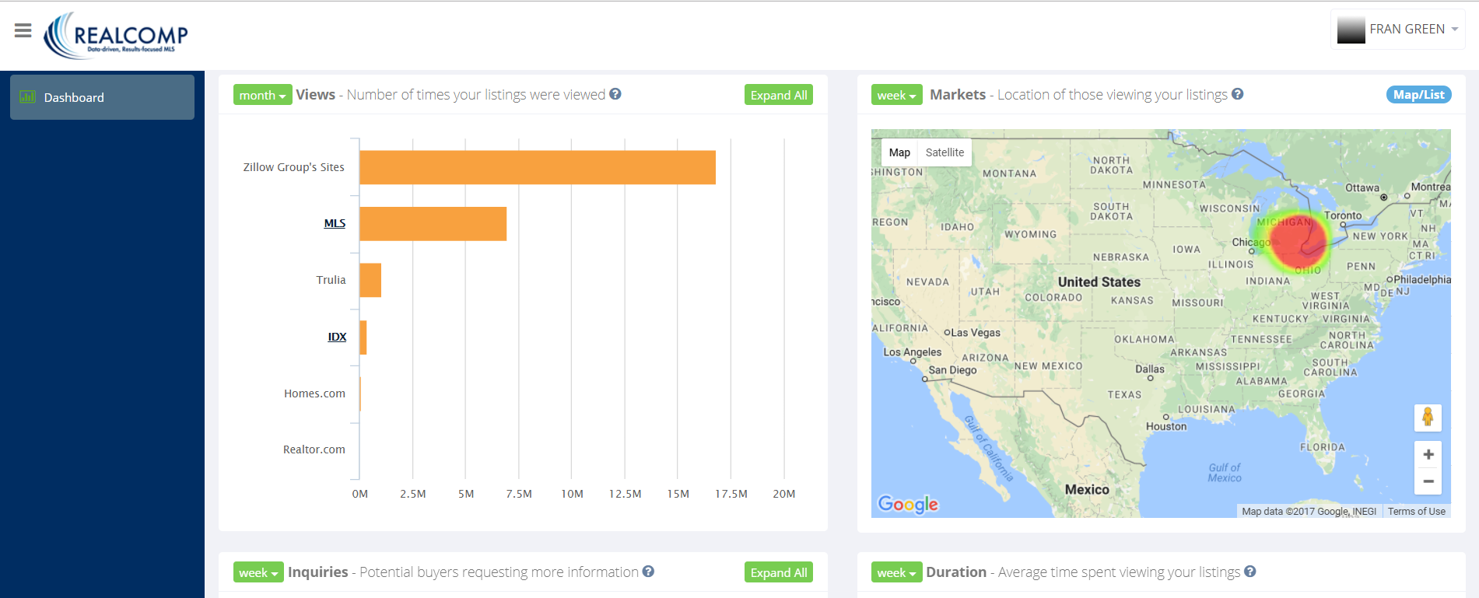
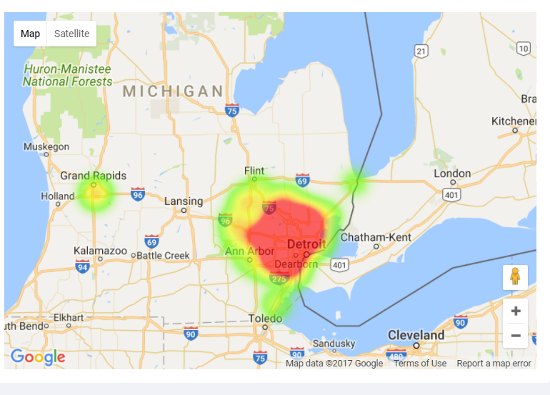
Views | Markets | Visitors | Inquiries | Saved Listings | Shares | Inventory | Active Reports
“Markets” allows you to zoom in and out (on the map) to see
locations of viewers.

Slide 8

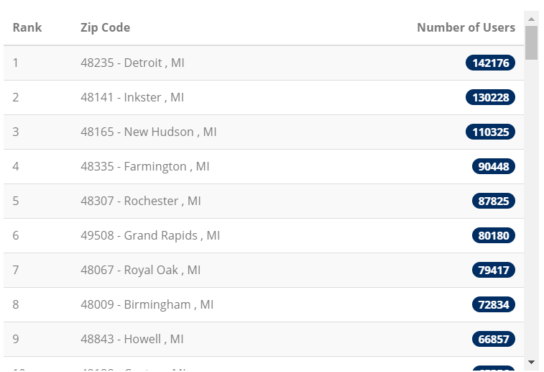
Views | Markets | Visitors | Inquiries | Saved Listings…
The “Map/List” toggle option allows you to see a list of the number of users viewing your listings by Zip Code.

Slide 9
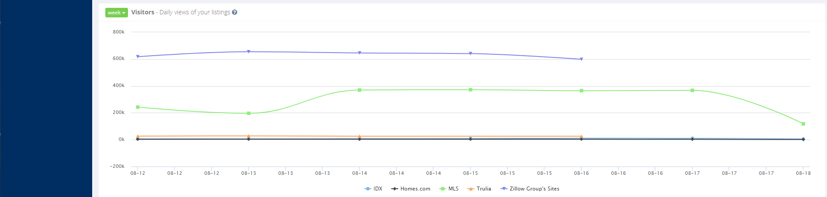
Views | Markets | Visitors | Inquiries | Saved Listings | Shares | Inventory | Active Reports
3
Visitors: Shows the number of daily views your listings have captured through the various sites.

Slide 10
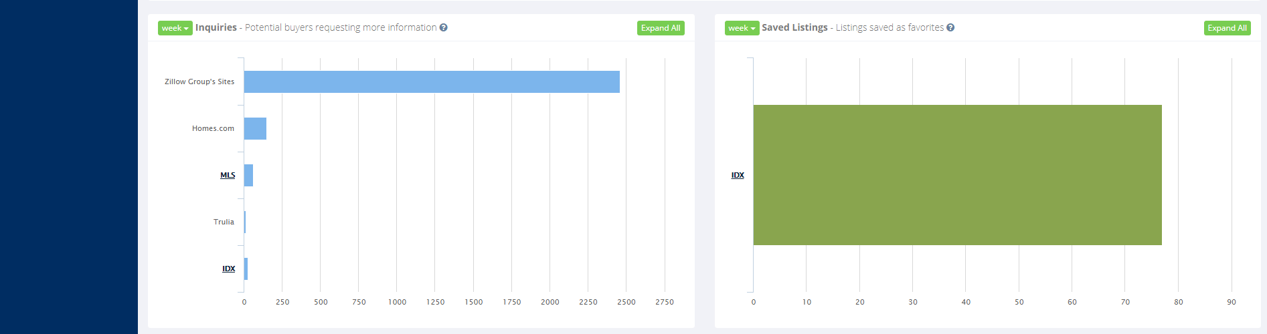
Views | Markets | Visitors | Inquiries | Saved Listings | Shares | Inventory | Active Reports
4
5
Inquiries: Shows how often potential buyers have requested more information on
your listings through the different websites.
Saved Listings: Shows the number of listings that have been saved as favorites.

Slide 11
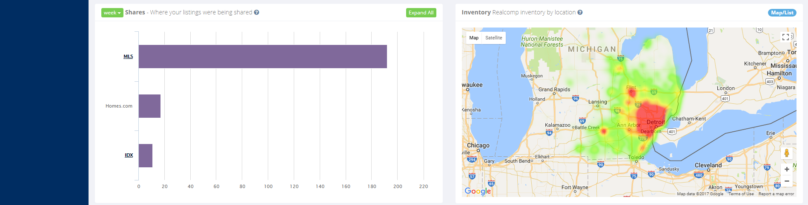
Views | Markets | Visitors | Inquiries | Saved Listings | Shares | Inventory | Active Reports
6
7
Shares: Shows
the sites from which listing “shares” (to social media) are being generated.
Inventory: Shows Realcomp’s current inventory by location. This shows where inventory is most heavily populated.

Slide 12
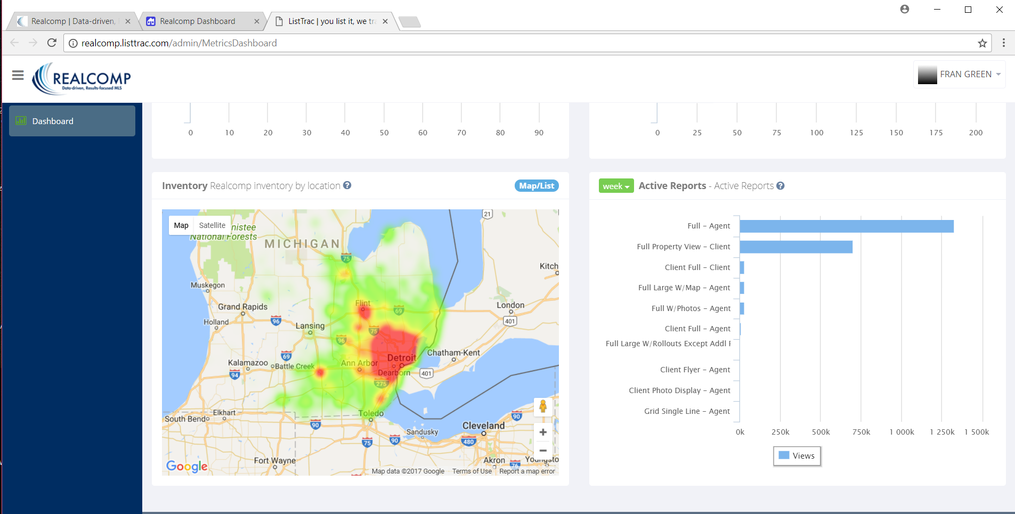
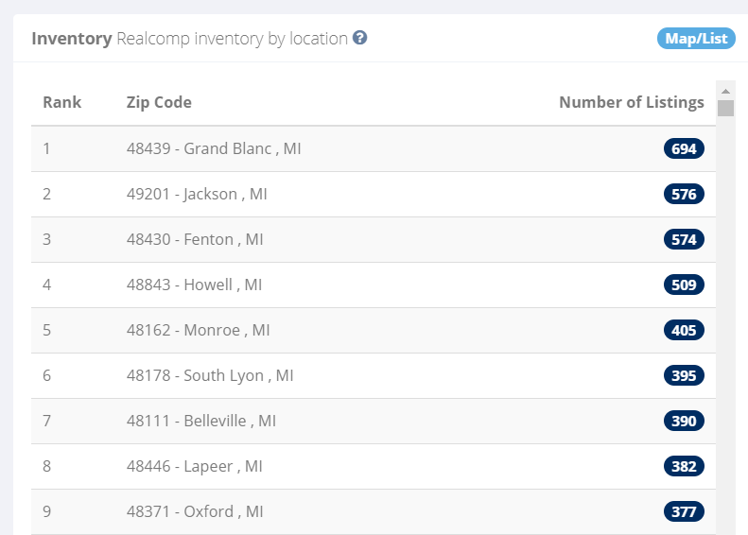
Views | Markets | Visitors | Inquiries | Saved Listings | Shares | Inventory | Active Reports
The “Map/List” toggle option allows you to see a list of the number of listings in Realcomp’s inventory by Zip Code.

Slide 13
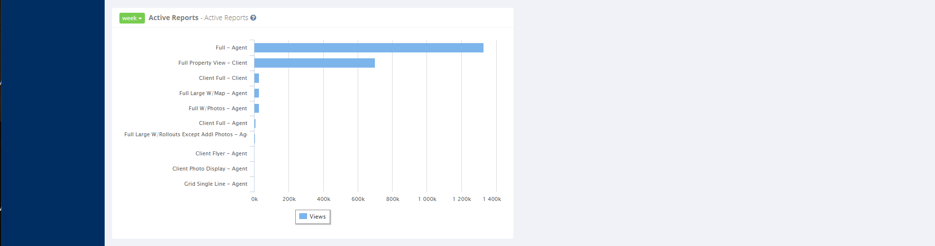
Views | Markets | Visitors | Inquiries | Saved Listings | Shares | Inventory | Active Reports
8
Active Reports: Shows which Realcomp reports are most used in combination with your listings.

Slide 14
      A detailed explanation for each of the metrics categories is available through the corresponding question mark/help feature.

Slide 15
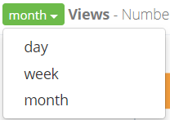
          For any of the metrics, you have the option of modifying your timeframe to 1 day (the last 24 hours), 1 week (the last 7 days), or 1 month (the last 30 days).

Slide 16
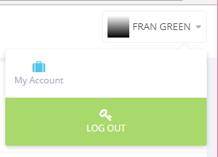
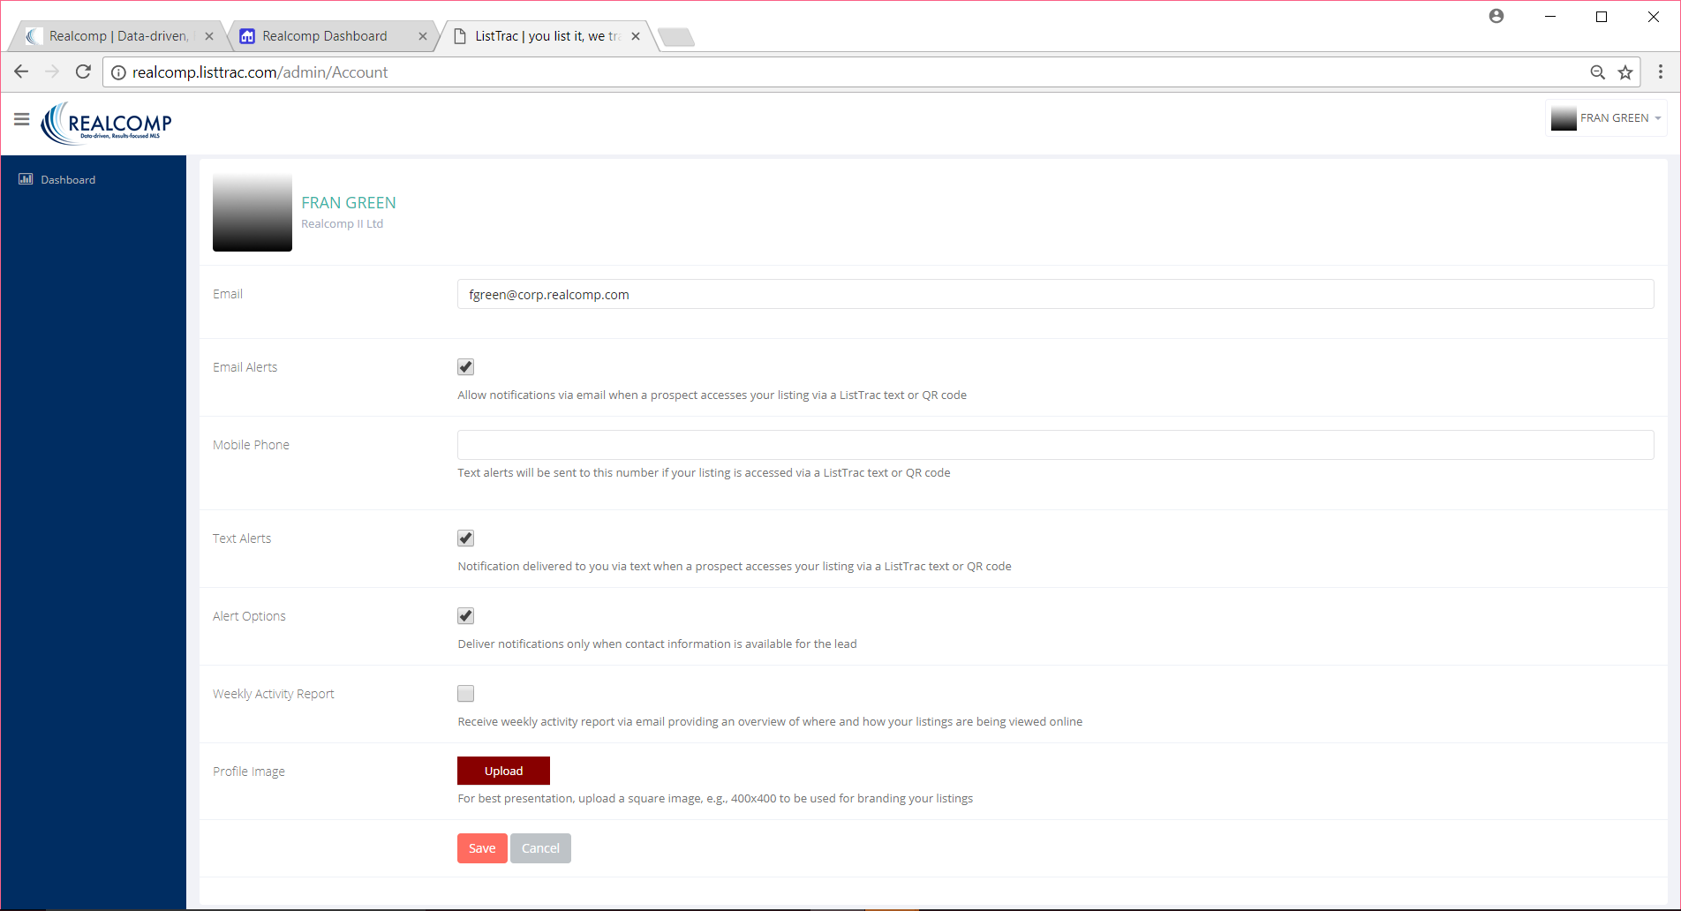
My Account
My Account contains various notification settings, which enable you to be notified (any number of ways) anytime your listings are accessed. Set these notifications up based on your personal preferences!

Slide 17
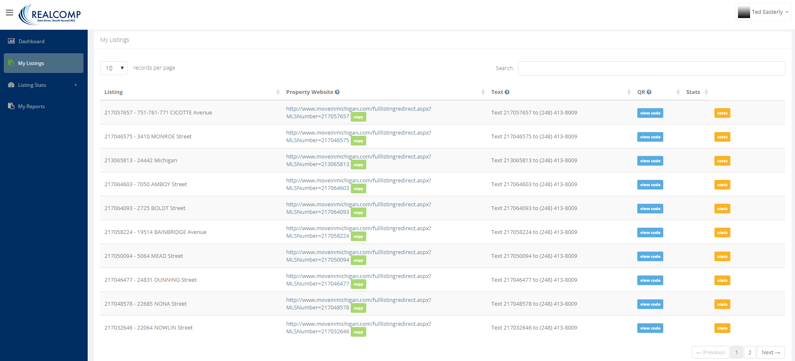
Available Metrics Under the “My Listings” Menu Item
My Listings allows you to easily accomplish several different tasks that
can help you market your listings! These include:
1) Access a URL for any of your listings on MoveInMichigan.com. You can quickly “copy and paste” this URL into an e-mail, text message, etc. that you share
with others in marketing the listing.

Slide 18
2) Provide prospects with a dedicated phone number and an MLS number. These can be published in marketing materials (i.e. listing flyers, listing advertisements, signs, etc.) and provided to potential buyers so they can request additional
listing details via text!

Slide 19
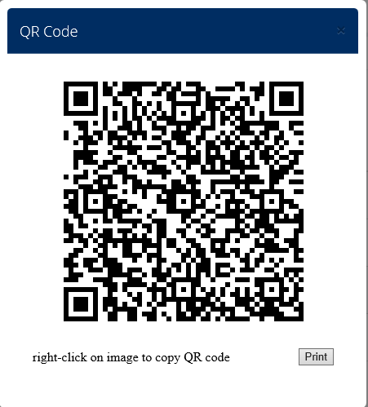
3) Generate a Quick Response (QR) Code (sample shown below) for your listing. Include this in your marketing materials (i.e. listing flyers, listing advertisements, etc.) to enable prospects to easily scan the code with a smartphone to obtain additional listing details!

Slide 20
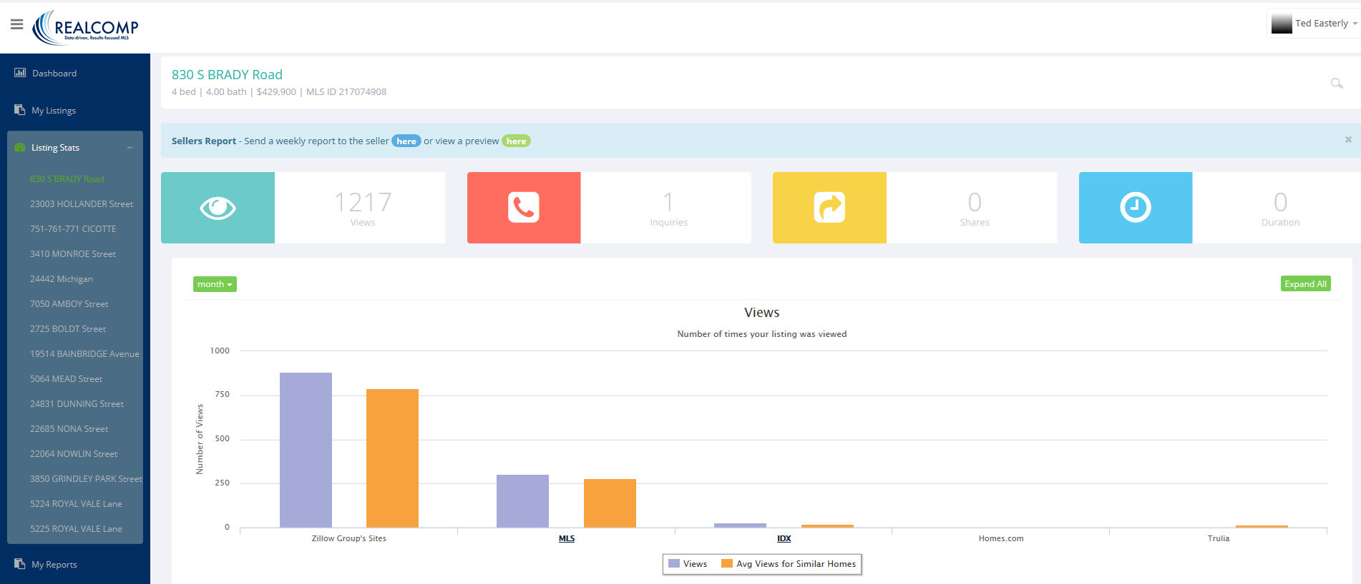
4) View Stats for your listing(s). Access Internet traffic being generated on your listings and share these numbers with your sellers!
Keep them informed about your Internet-marketing efforts and their results.

Slide 21
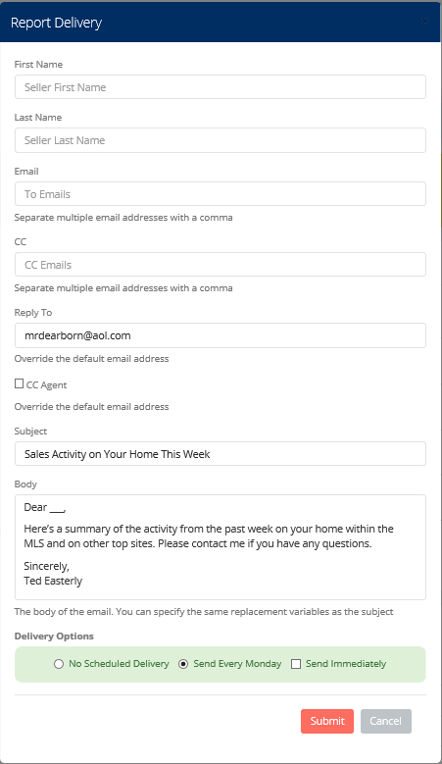
5) Send a weekly report of your listing traffic to
your seller!
Note: Each of your listings appear in ListTrac at the far left of this screen.

Slide 22
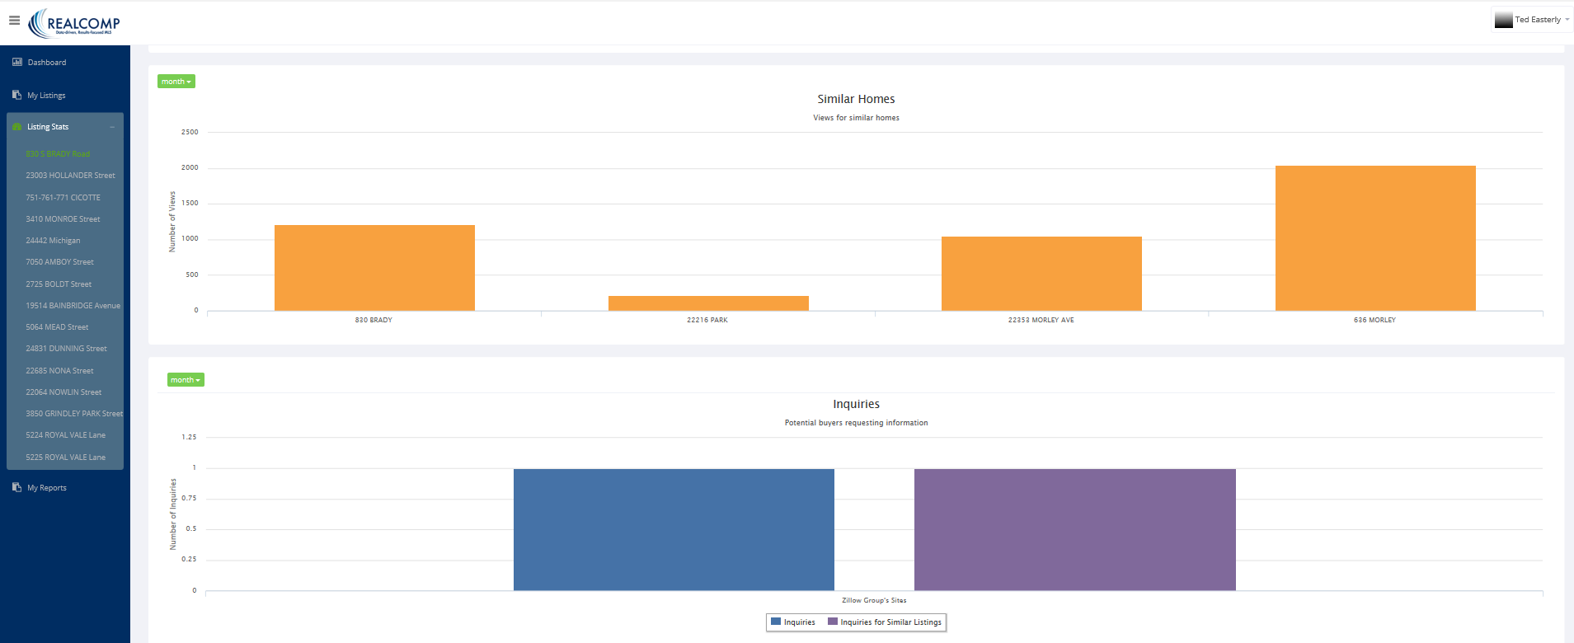
6) Compare traffic on your listing to traffic on similar homes (and more) – and know how your listing traffic compares to that of competing listings!

Slide 23
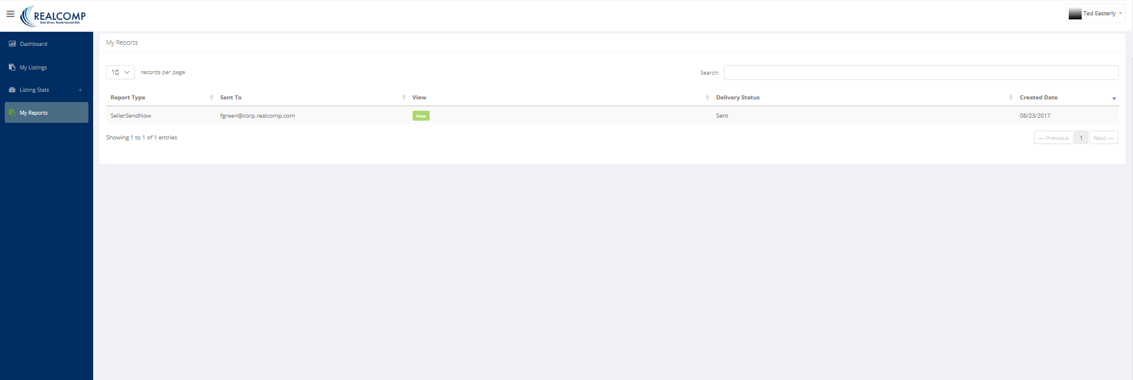
“My Reports” Options
And, last but not least, My Reports enables you to access any reports you have sent to your clients.

Slide 24
August, 2017
Allow ListTrac to keep you and your
clients in-the-know regarding how
your listings are performing on the
Internet. Access ListTrac now from
the Realcomp Login Dashboard!

