Slide 1
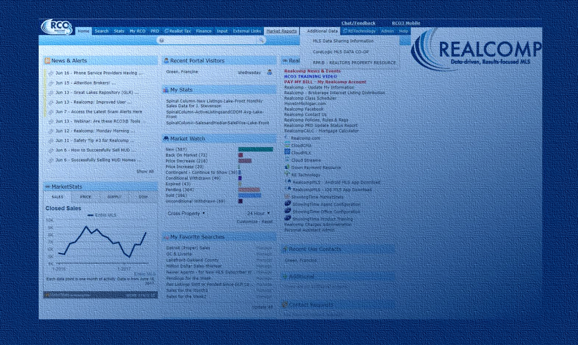
RCO3® 7.0.2
Enhancement Highlights
Now Available as of 7/20/17

Slide 2
All New
Mobile-Compatible,
Device-Driven Interface

Slide 3

RCO3® is now mobile-compatible, device-driven. This includes fluid layouts that auto-fit to each user’s screen no matter the device, screen size, etc.

Slide 4
OS/Browser Compatibility Improvements

Slide 5






RCO3® is now compatible with the latest browser versions supported by mainstream operating systems. The improvement: all users who are
using non-supported versions will receive a warning at login to encourage
upgrading for a better user experience.

Slide 6
Updated Client Portal

Slide 7
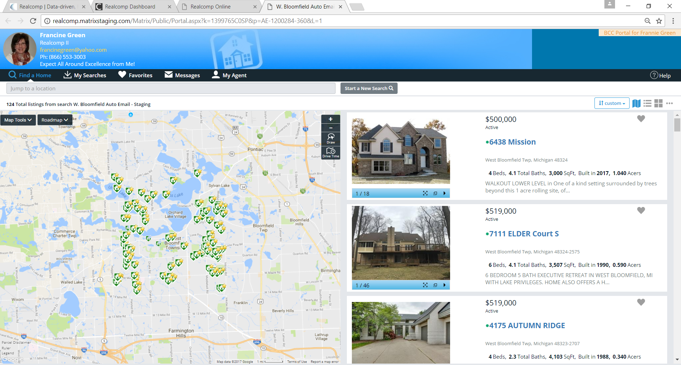
The Client Portal now has an all new look and
more intuitive usability!

Slide 8

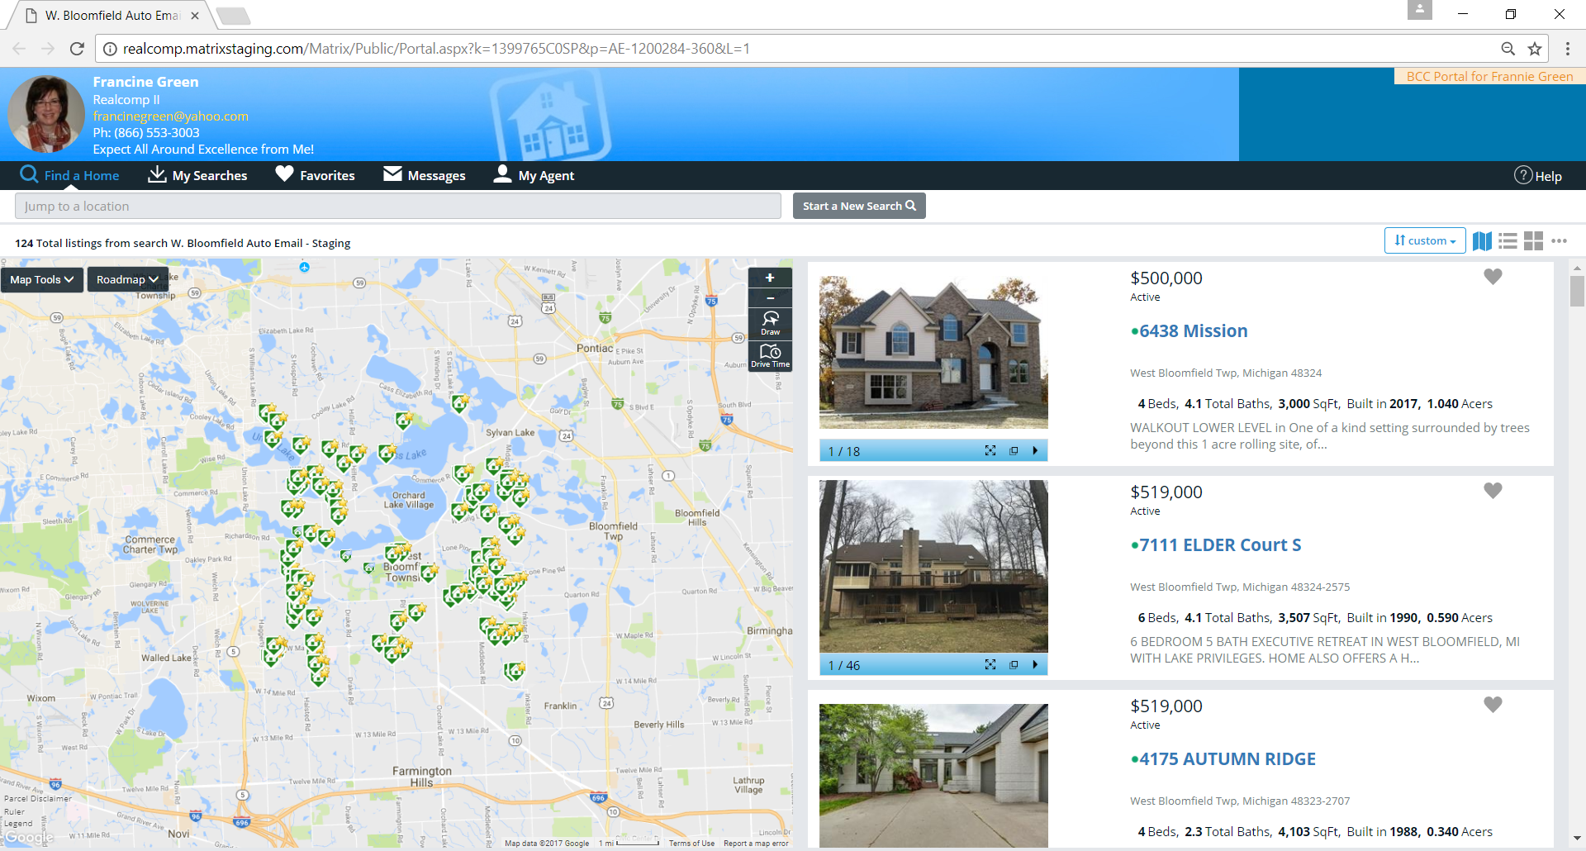
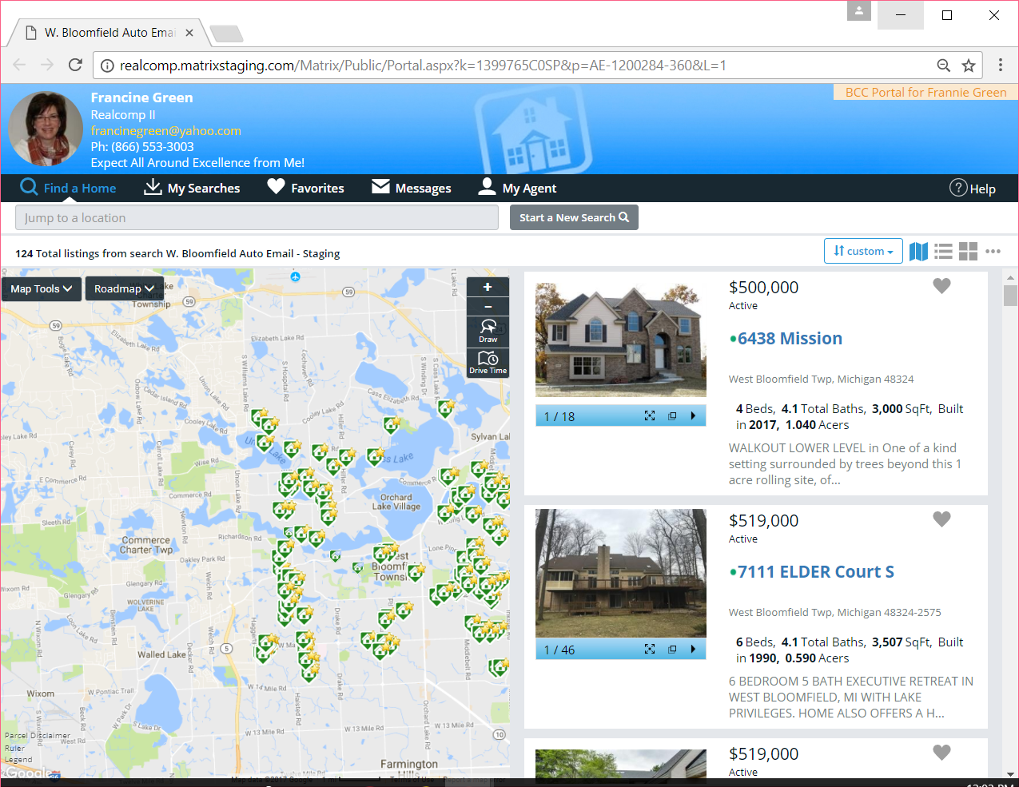
Client Portal Key Improvements – Cont’d
  Fluid layouts which auto-fit content to each user’s screen, no matter the size, …
  … are now included for a better user experience!

Slide 9
Client Portal Key Improvements – Cont’d
  All users now access the new Client Portal regardless of the particular device they use. This means the previous mobile version is no longer being used … giving all users a more consistent experience.

Slide 10
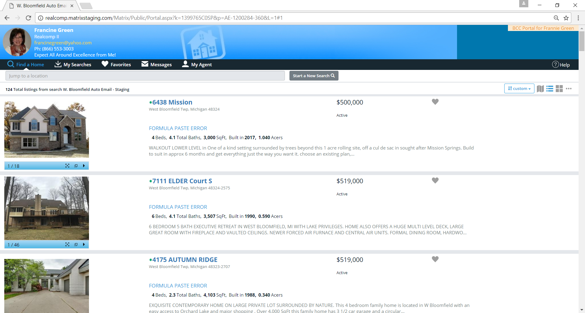
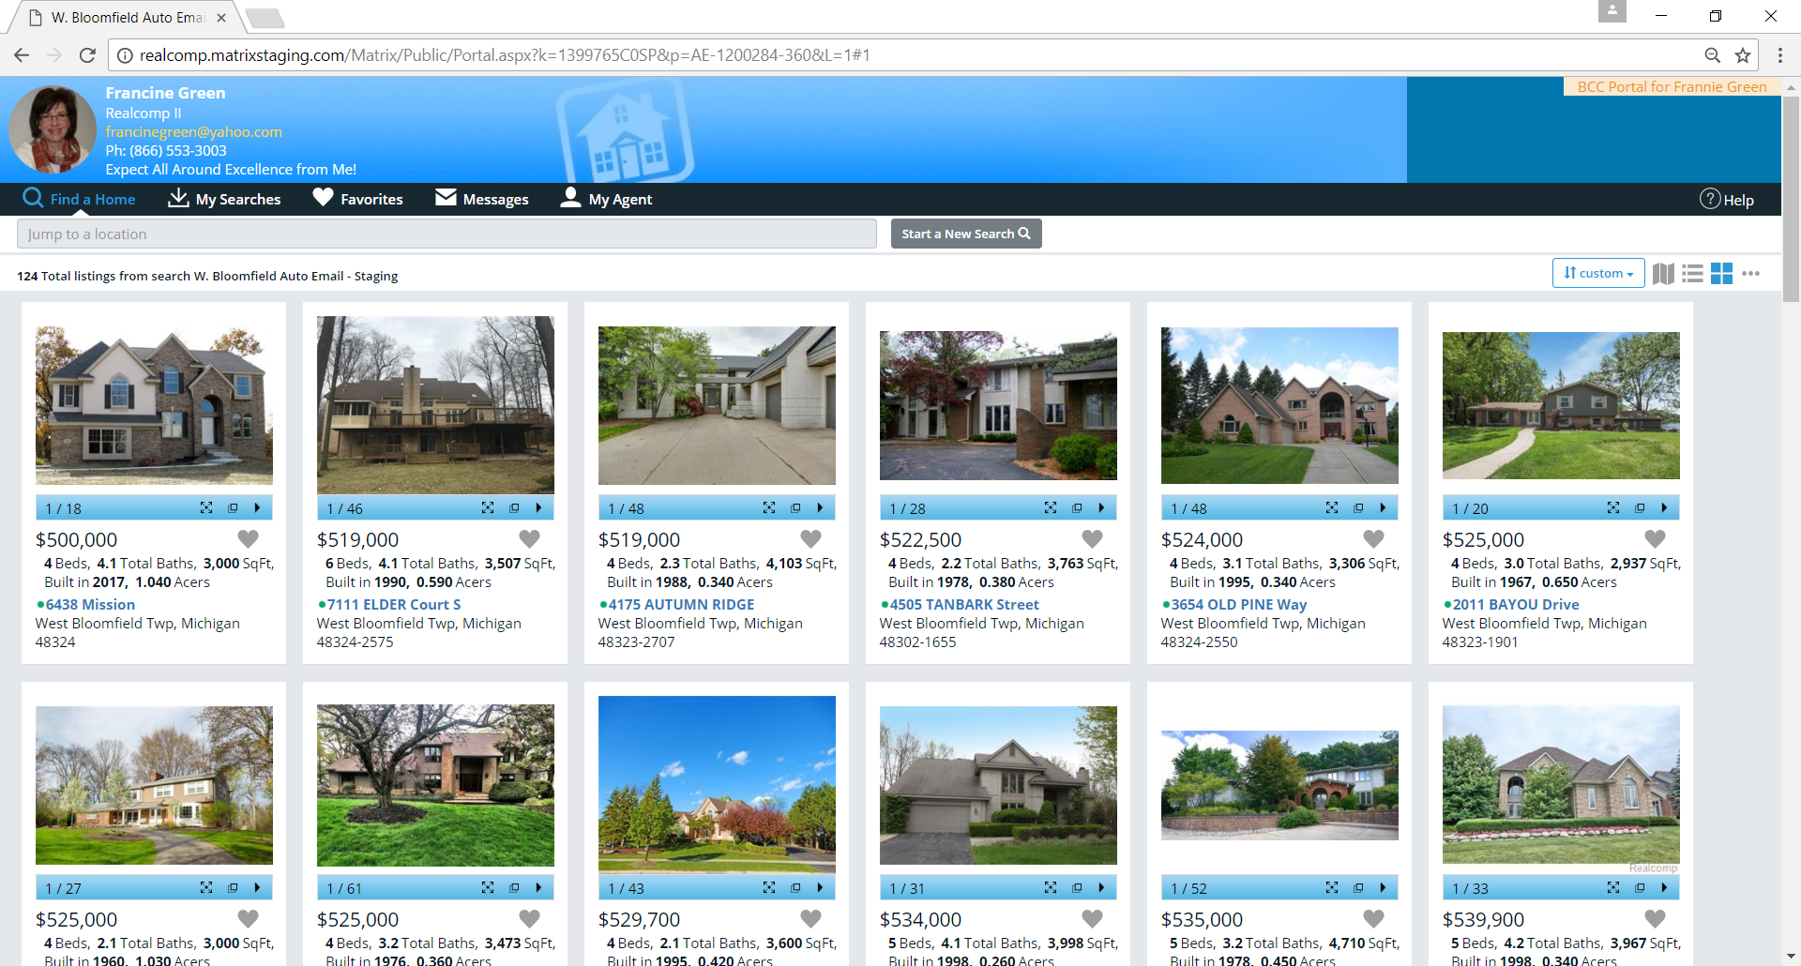
Client Portal Key Improvements – Cont’d
  A standard set of layouts is now available for browsing listings, including a
  Map View, List View, and Gallery View.
List
Map
Gallery

Slide 11
Client Portal Key Improvements – Cont’d
★ Map View - the New Default View

Slide 12
Client Portal Key Improvements – Cont’d
List View – is Another Selectable Display

Slide 13
Client Portal Key Improvements – Cont’d
Gallery View - is Another Selectable Display

Slide 14
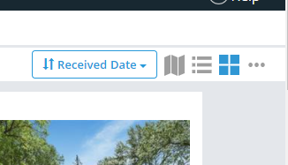
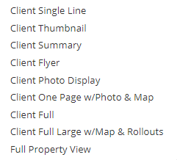
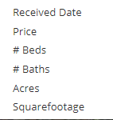
Client Portal Key Improvements – Cont’d
Sort Order, Views, and Additional Report Formats Controlled through the Sub-Menu

Slide 15
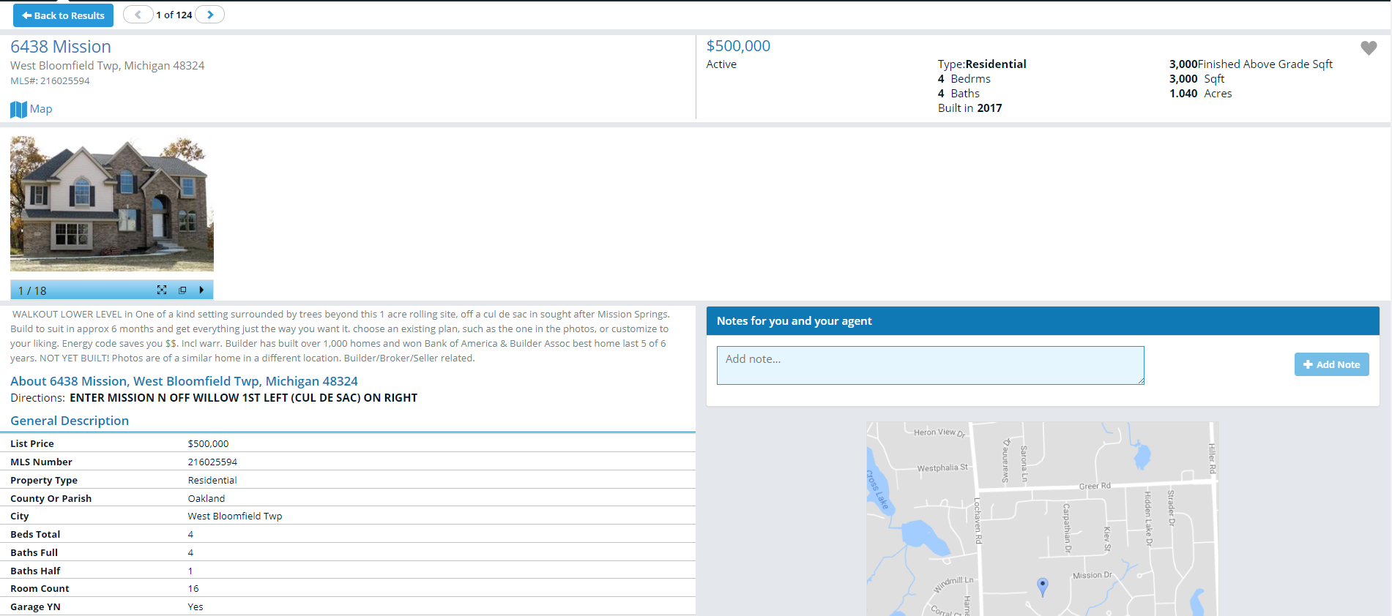
Client Portal Key Improvements – Cont’d
Clicking the Property Address Takes the User to More Listing Details

Slide 16
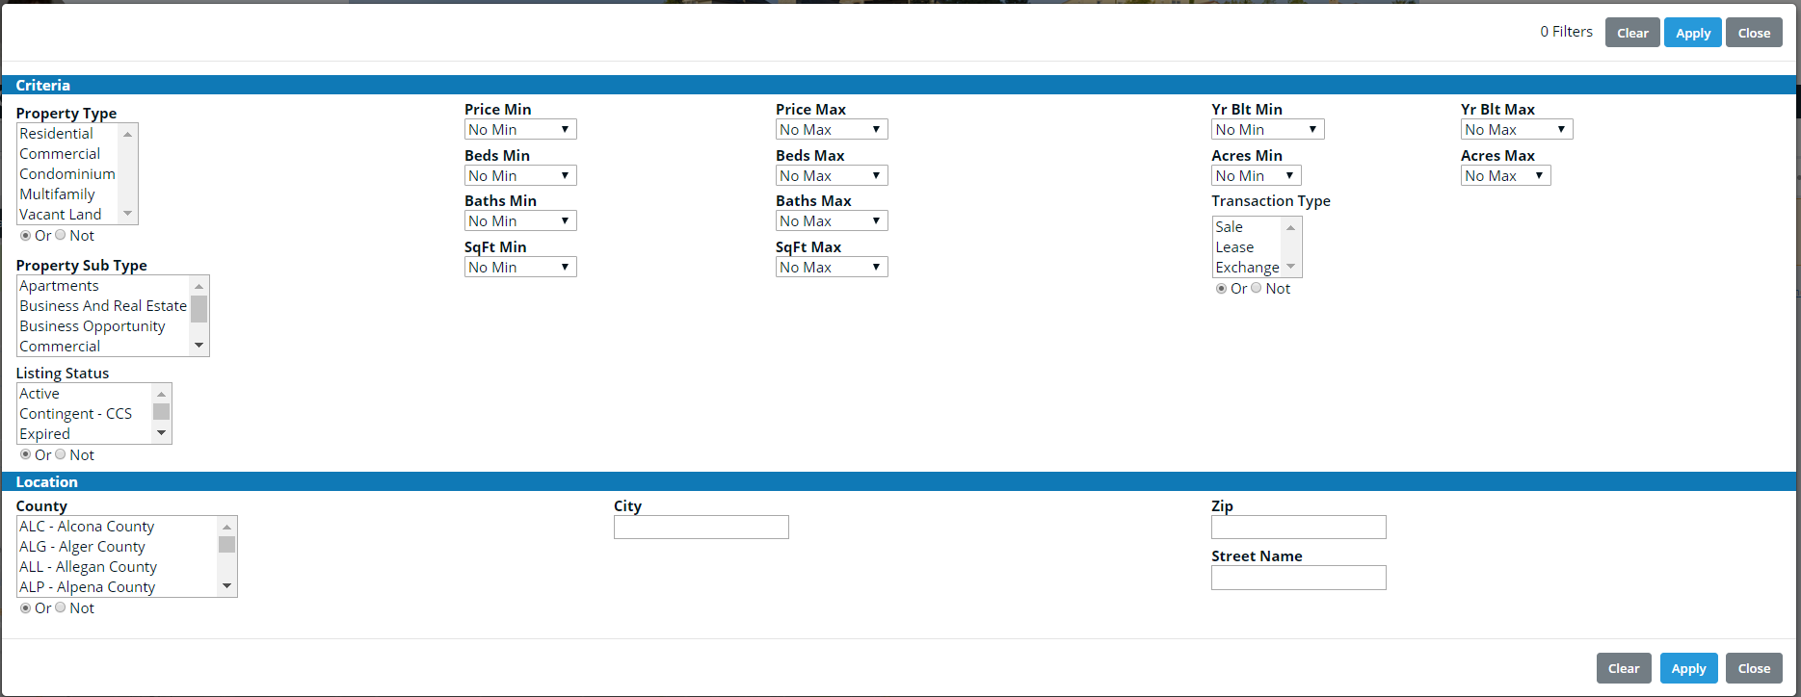
Client Portal Key Improvements – Cont’d
  City, Subdivision, and School District searchable through the Portal. This allows clients to include these fields in searches they create. When these fields are used,
  the user’s current map location will not be applied as part of the criteria.
Subdivision
Fields may not
appear exactly
as shown.
School District

Slide 17
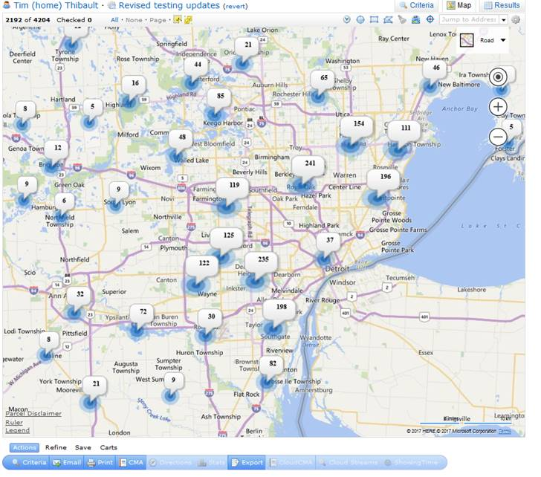
Client Portal Key Improvements – Cont’d
Pin clustering now appears on the map when the number of search results warrants that particular display making for a cleaner, more organized display! Users also have the ability to click to zoom in on smaller regions.

Slide 18
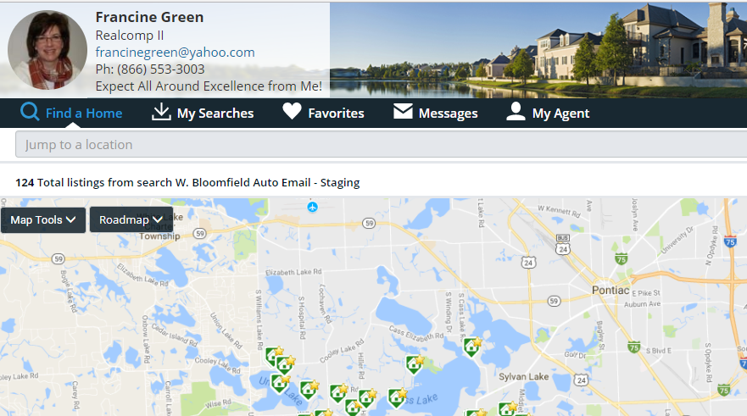
Client Portal Key Improvements – Cont’d
  Separate pages within the Portal provide access to Find a Home, My Searches, Favorites, Messages, and My Agent. All searches, either saved by the client or created by their agent are accessible under My Searches, making for organized access to all searches.

Slide 19
Client Portal Key Improvements – Cont’d
  A history of all content emailed to clients, including the ability to view just the new
  and changed listings (from auto email updates), is available through Messages.

Slide 20
Client Portal Key Improvements – Cont’d
  All notes added to listings by either the client or the agent are accessible through Messages.

Slide 21
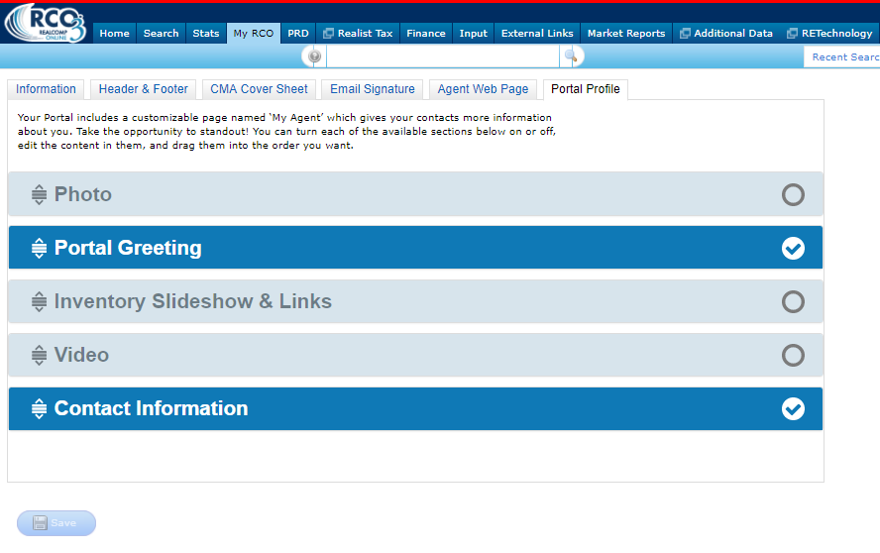
Client Portal Key Improvements – Cont’d
  An agent-customizable profile page, which can include text, photo, video, current listings, and contact information is available. Bringing you more ways to enhance your branding and make your messaging stand out.

Slide 22
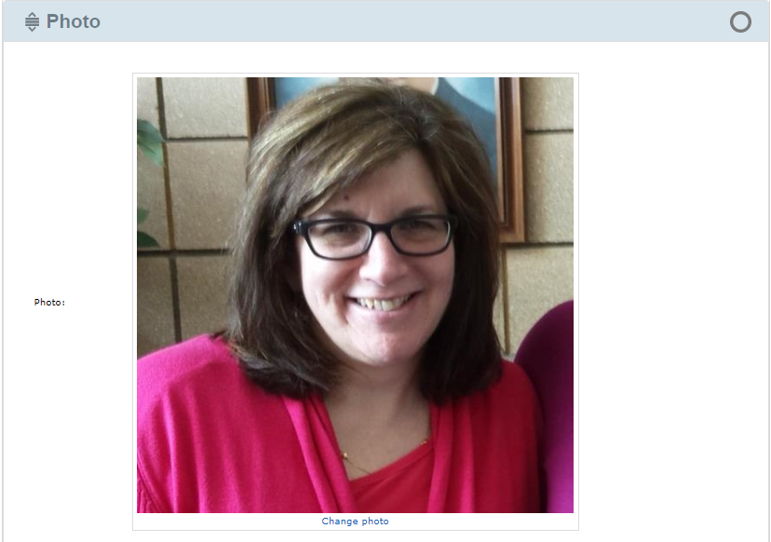
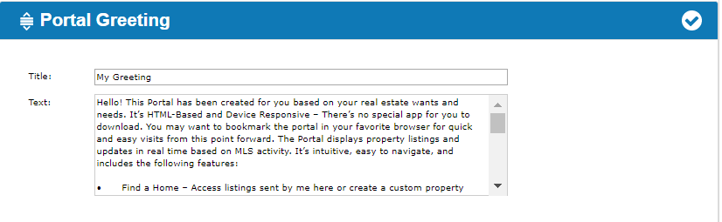
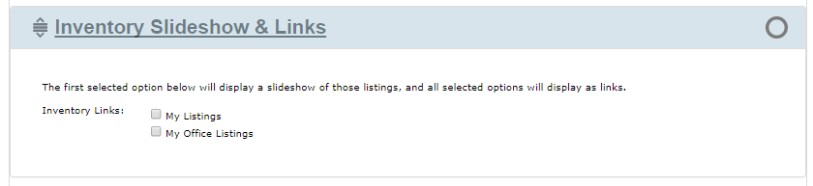
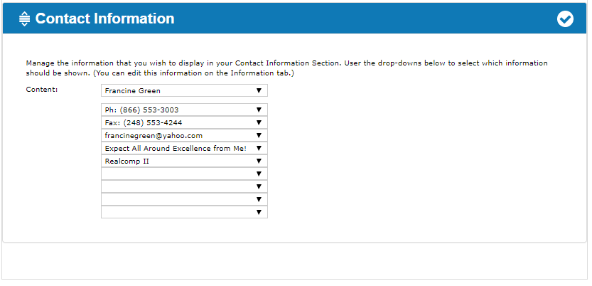
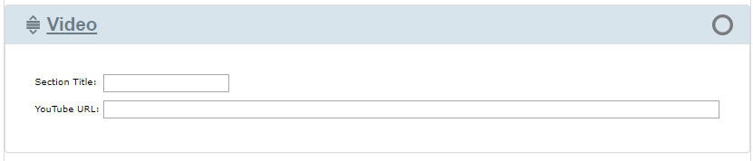
Client Portal Key Improvements – Cont’d
  To access the settings for the agent-customizable profile page, go to My RCO > Settings > Portal Profile (under My Information).

Slide 23
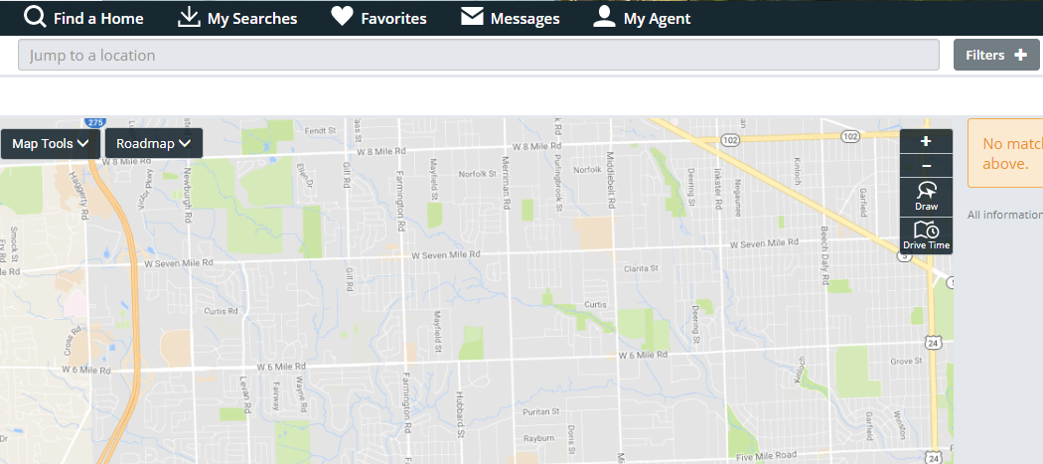
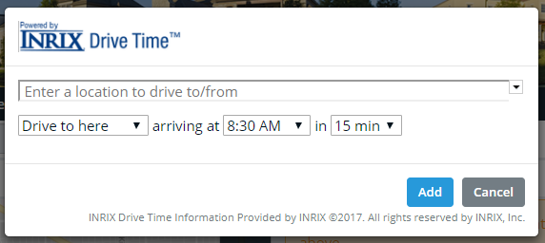
Client Portal Key Improvements – Cont’d
  DriveTime searching through the map is available – This enables your client to
  “Find all available properties within an xx-minutes drive to work”. Now that’s convenience!

Slide 24
New Agent Headers and Footers

Slide 25
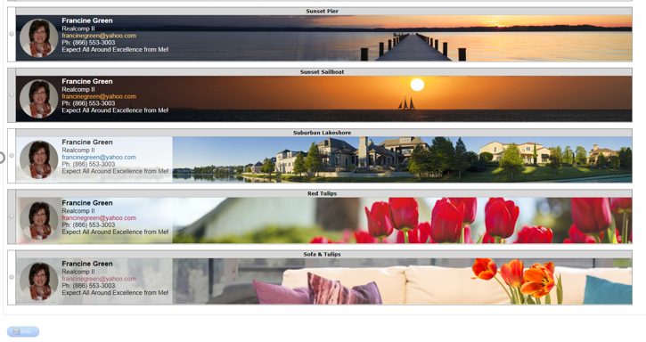
Headers & Footers - New Agent Header Choices!
  Agent Headers and Footers have been completely updated to provide you with lots of choices for a fresh new look! A larger header size is available–up to 1600 pixels wide by 120 pixels tall–with a library of spectacular new header images. Click the Play button (below) to view a quick list. City of Detroit landscapes are also available.
Play for Video of New Header
Choices

Slide 26
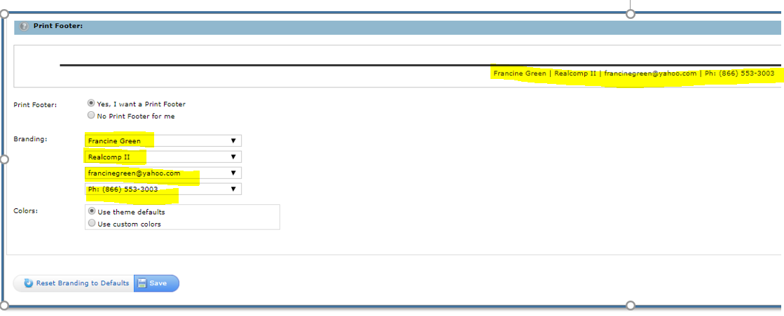
Headers & Footers - New Footer Options
  Agent Footers have also been updated. Simplified footers, completely customizable by you, with
  up to four (4) branding fields are now included.

Slide 27
Headers & Footers Key Improvements – Cont’d
  Support for Brokers to add Header/Footer packages, available to licensees within their offices only, is also available.
    Header images need to be created in 1600 x 120 pixels format and saved as
    a JPG image. These can then be forwarded to Realcomp’s Customer Care Dept.
    at support@realcomp.com.
  Agent-controlled branding also displays even when an Agent (or
  Broker) uploads a custom image.
  Consistent branding and messaging for Brokers and Agents is the outcome.
--- Coming Soon ---

Slide 28
Notifications of Client Portal Activity

Slide 29
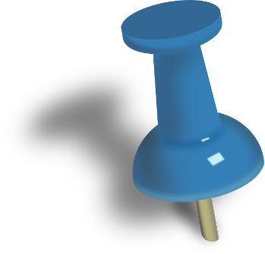
Client Portal Notification Options
Agents can be notified (optionally) via email or text of recent Portal activity by
their contacts, and/or receive a daily summary email of activity for
all their contacts.
  Trigger notification options include:
    A contact visits their Portal for the first time
    A contact visits their Portal (any visit after the first time)
    A contact adds notes to a listing
    A contact saves a listing as a favorite
    A contact removes a listing as a favorite
    A contact saves a listing as a possibility
    A removes a listing as a possibility
    A contact discards a listing
    A contact removes a listing from Discards
    A contact saves a search
  Portal Activity Notifications can be
  accessed/modified through the
  Settings option under My RCO.
Each MLS Subscriber may choose whether they wish to receive these notifications and how they wish to receive them: ASAP via email, ASAP via text, or in a daily summary email.
Know as much as you want to know about the activity of your clients!

Slide 30

Client Portal Notification Key Improvements – Cont’d
  ASAP notifications of a contact visiting the Portal are sent immediately, allowing the Agent to know when a contact is looking at real estate (which may be an ideal time to contact them);
  ASAP notifications of all other activity are sent only when no other notification for that contact has been sent within the past 10 minutes. This prevents a deluge of notifications from occurring if the contact is very active and allows context for multiple actions on a single listing to be included within the same notification (i.e. saved as a favorite and added notes).

Slide 31
Updated Agent
Web Pages

Slide 32
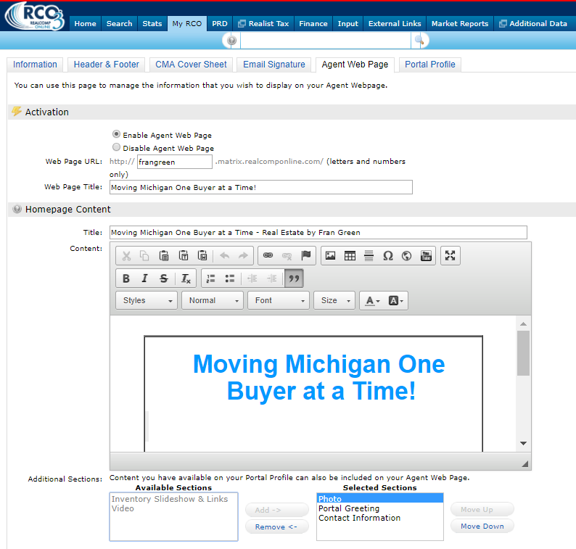
  Agent Web Page Improvements
  Agent Web Pages have been
  updated to reflect the same
  core changes as the Client
  Portal, including fluid layouts
  that fit content to the user’s
  screen, a standard set of
  multiple layouts for browser
  listings, etc.
  The MLS Subscriber may enrich
  their Home page to include
  any of the same content
  sections as their Portal’s profile
  page, supplementing the primary
  content they have already
  configured.

Slide 33
Updated IDX Search Pages

Slide 34
IDX Search Page Improvements
  IDX search and results screens have been updated to reflect many of the same core changes as the Client Portal, including:
      Fluid layouts, which fit content to the user’s screen.
        In order to achieve this, the MLS Subscriber framing the IDX search must change the dimensions of their IDX frame from pixel-based dimensions
        to fluid percentage-based dimensions.
      The style of text and buttons has been updated to reflect the fresher look of the new Portal.
        Button colors can now inherit the same color scheme as defined
        for the header background and header text.

Slide 35
IDX Search Page Improvements – Cont’d
  IDX Map Searches, like the new Portal, have been updated to support:
    A standard set of multiple layouts for browsing listings.
    Support for additional geographic fields on the search form.
    Pin clustering on the map when the number of results warrant
    this display.

Slide 36
Map Improvements

Slide 37

        Map Improvements
  All map images and map-related
  functionality in RCO3® will use Google
  instead of Bing for more up-to-date data.
  General functionality and behavior remains largely unchanged.
  Small differences worth noting are:
    Both street maps and satellite views are more up-to-date in most locations.
    Parcel boundaries and building footprints display on the street map in many locations.
    The printable map display, as well as the map page in the CMA, now color each
    pin based on the associated listing’s status.

Slide 38
ListTrac Integration

Slide 39

ListTrac Integration
  RCO3® now integrates with ListTrac to provide
  analytic insights regarding listing activity. This
  integration will allow Realcomp to track:
    All accesses of a listing’s full view in either RCO3® or on a Client Portal,
    including which display template was viewed. Note: A full view is any
    display which shows only one listing per page.
    All accesses of a listing’s pop-up photo gallery in either RCO3®
    or on a Client Portal.
    Important Note: Once Realcomp has had sufficient time to collect
    the analytics, we’ll share how these can be accessed by you.

